Slide 1
Data Science Basics in R:
Day 2: Data management

Slide 2
Goals for today
Explore github to access course materials
Understand what data management is
Identify some interesting sources of healthcare and public health data (if you don’t already have your own)
Load and clean your first dataset in R
Learn about and implement best practices for:
documenting your code
data dictionaries
doing reproducible research in R

Slide 3
Accessing course materials

Slide 4
What is github?
Have you ever saved a bunch of versions of a paper on your computer with different file names at different dates or times of day?
Backups are useful to save progress, understand what we’ve done before, and look into problems/bugs
Github is a tool do help do this with code

Slide 5
What is github?
We’ll talk more about github on the fourth day of this workshop. For now, I’d like you to be able to use it to access course materials any time you’d like to.
https://github.com/seaneff/data-science-basics-2023

Slide 6
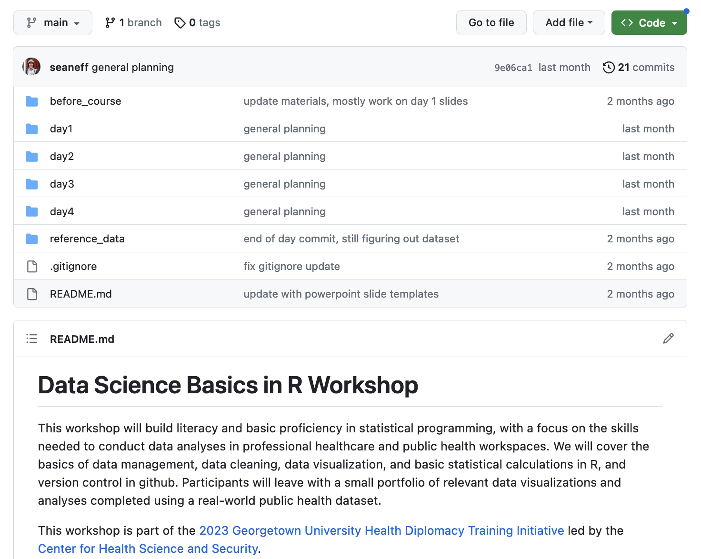

Slide 7
Day 2 course materials are in this folder
Import dataset button

Slide 8
Now you try!
Open the course github and click around for a few minutes
https://github.com/seaneff/data-science-basics-2023

Slide 9
What is data management?

Slide 10
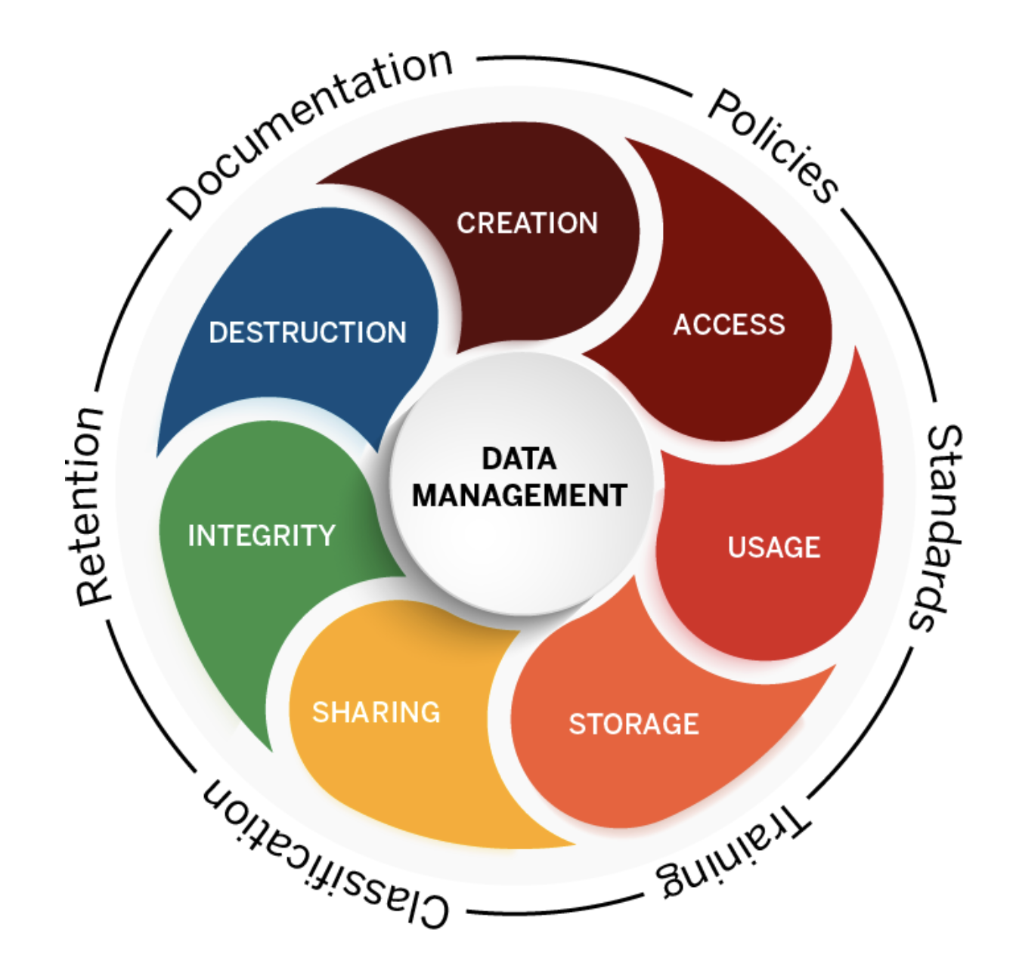
Data management
Data management is the practice of creating, maintaining, documenting, and securing data.
It includes data cleaning, among many other tasks.
Graphic from https://datamanagement.iu.edu/

Slide 11
What does data cleaning involve?
Better question: what doesn’t it involve?
Data cleaning tasks depending on what types of data you’re working with and where you got them!
Identifying and addressing missing values
Fixing “weird” characters
Combining multiple datasets
Deduplicating lists
Identifying other discrepancies…

Slide 12
Some useful sources of global public health data

Slide 13
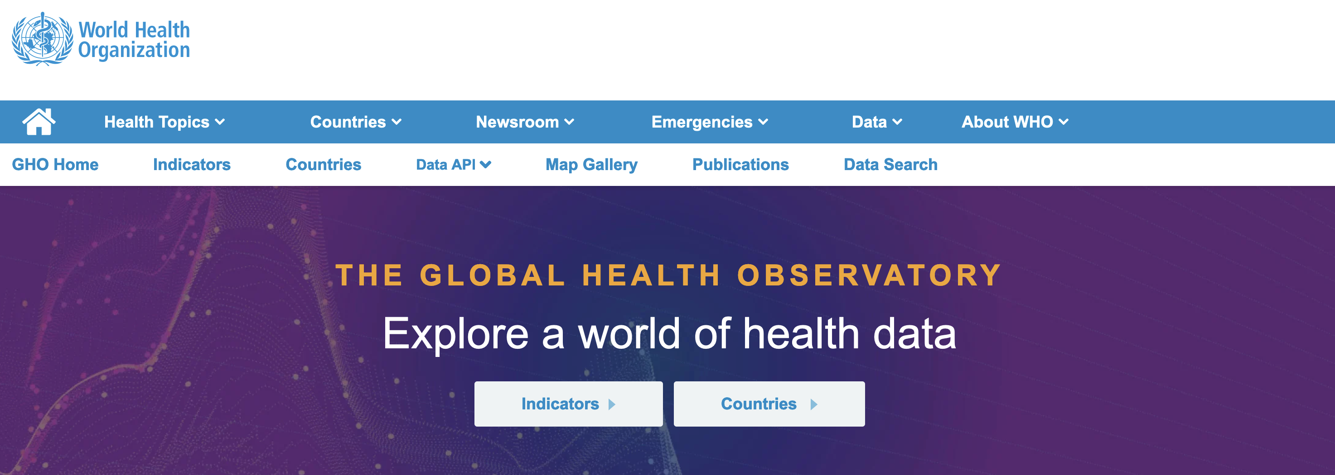
WHO Global Health Observatory
https://www.who.int/data/gho

Slide 14
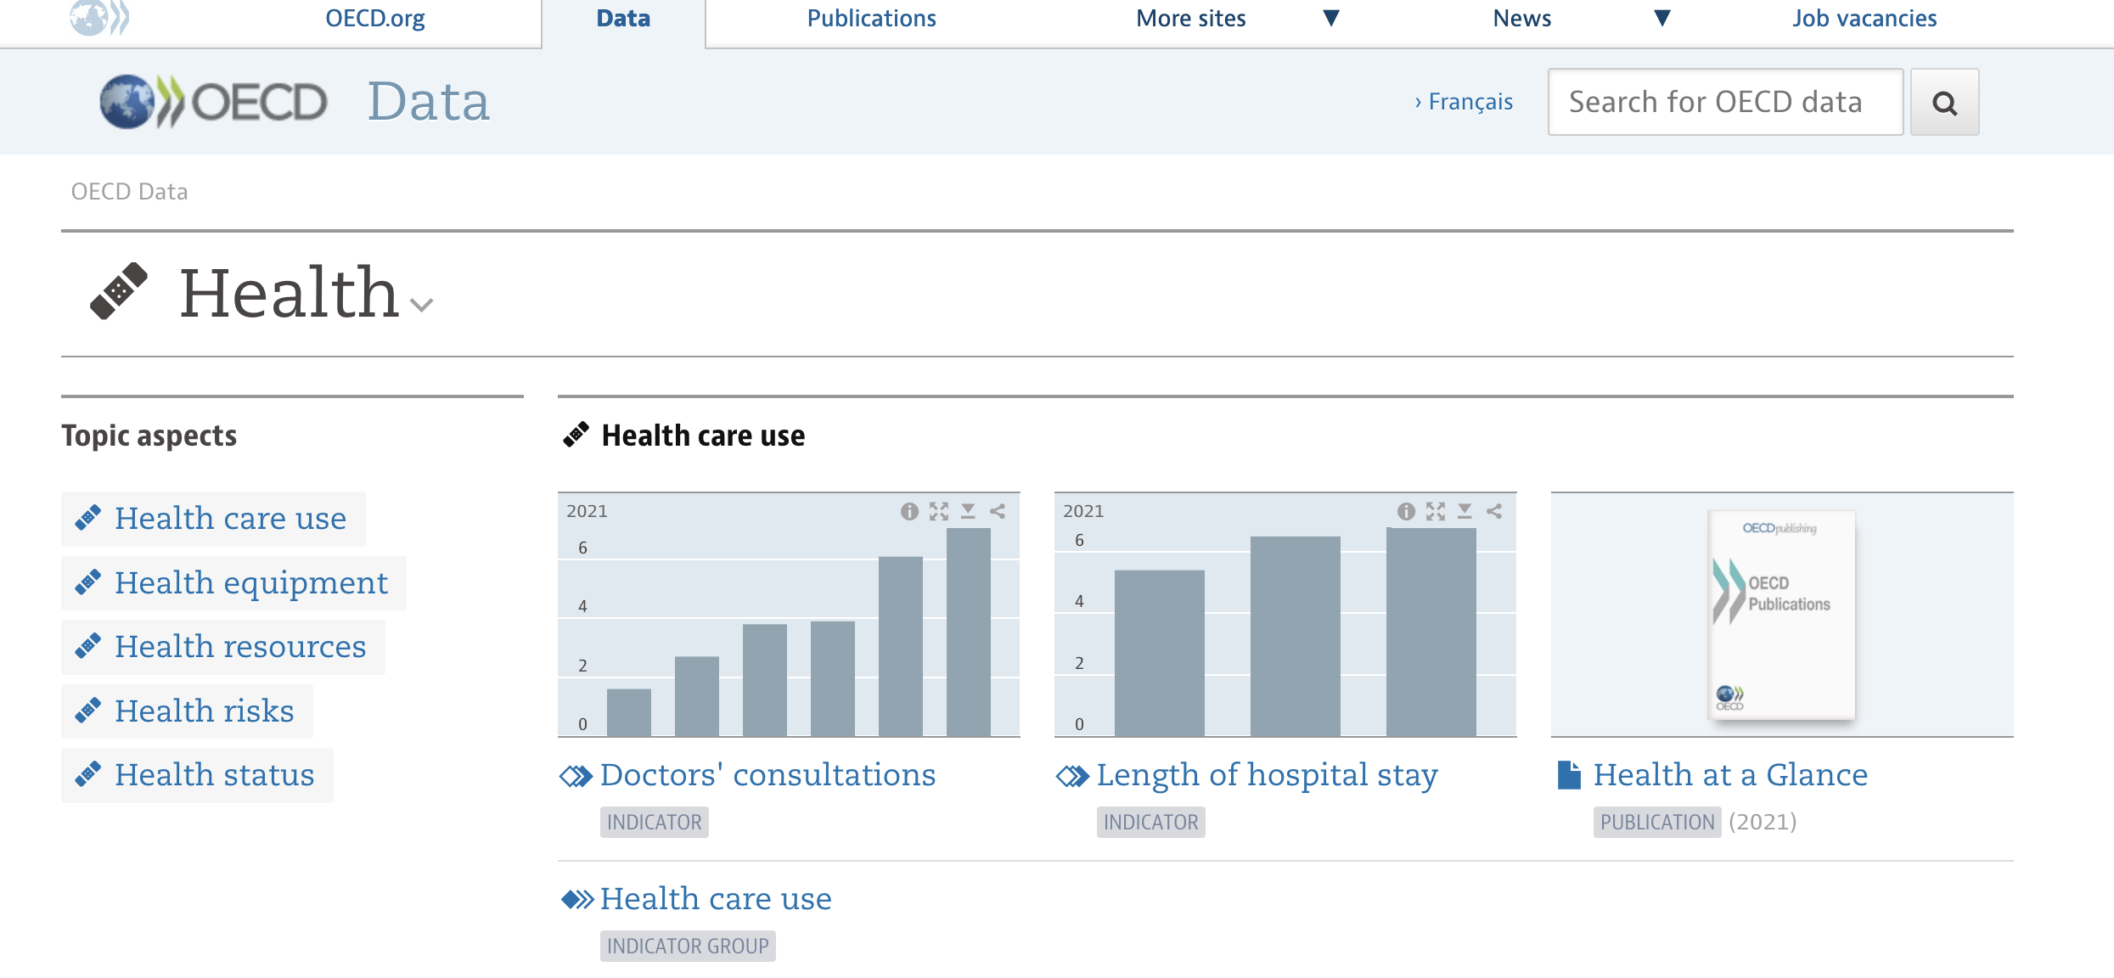
OECD Health Data Repository
https://data.oecd.org/health.htm

Slide 15
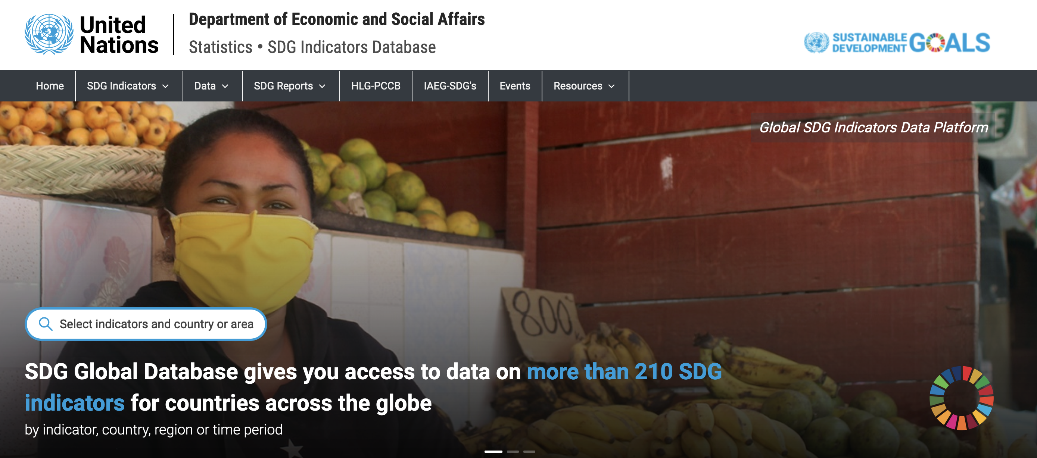
UN SDG Global Database
https://unstats.un.org/sdgs/dataportal

Slide 16
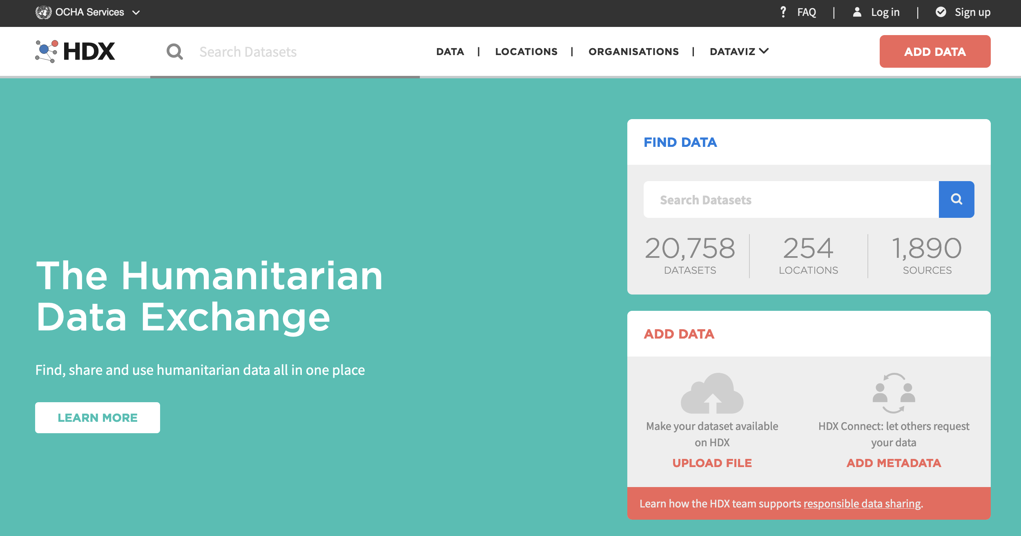
OCHA Humanitarian Data Exchange
https://data.humdata.org/

Slide 17

Demographic and Health Surveys
https://dhsprogram.com/

Slide 18
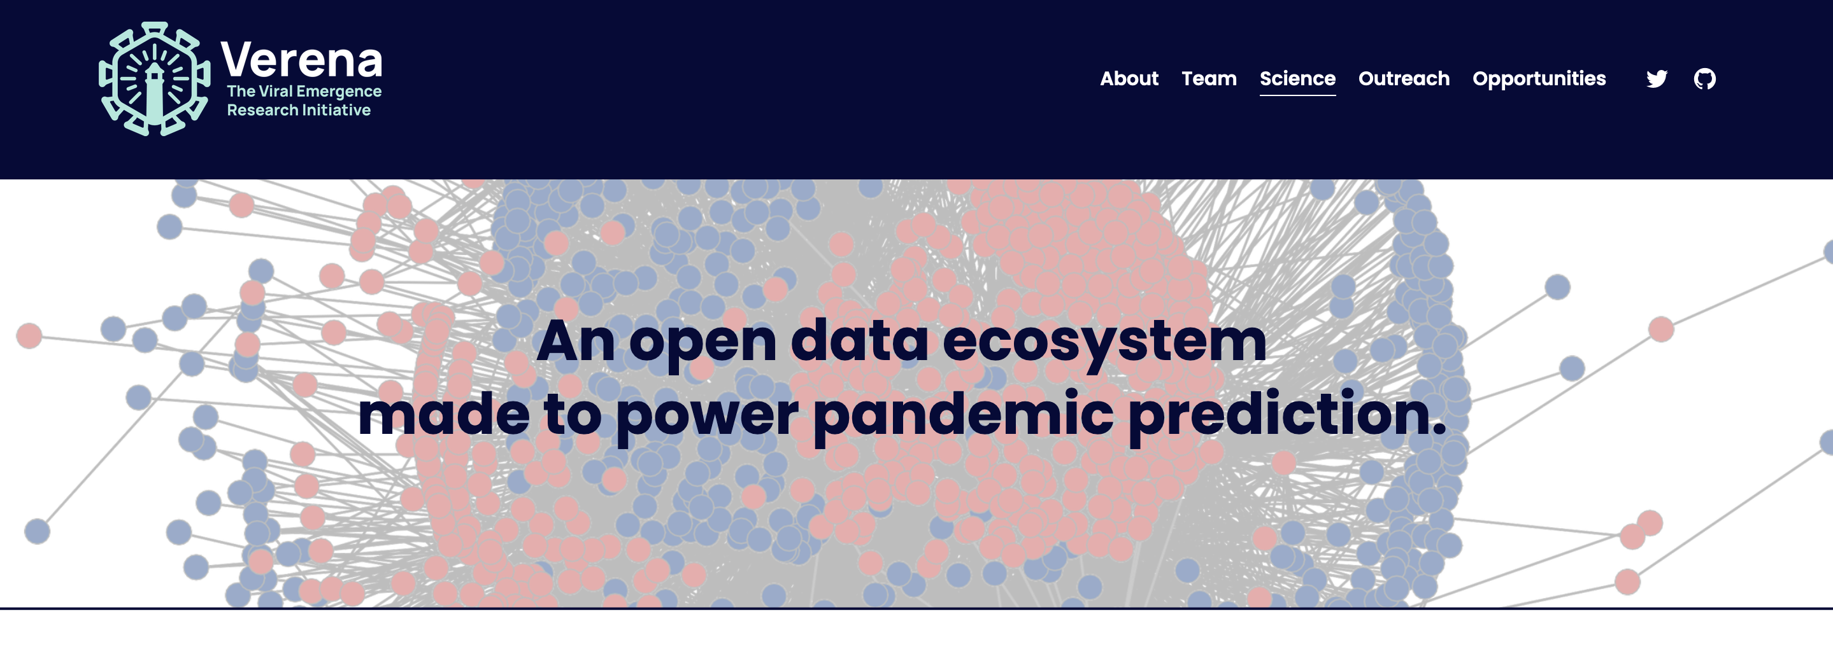
Verena
https://www.viralemergence.org/data

Slide 19
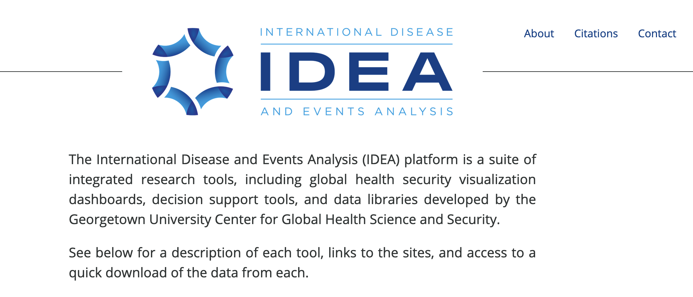
IDEA
https://ghssidea.org/

Slide 20
Let’s chat
What other datasets have you used for work or school?

Slide 21
Reading in a new dataset

Slide 22
Raw data files
We’re going to talk about structured, flat files today, but there are many types of data that R can work with!
Excel: proprietary file format (Microsoft), but common
CSV: comma-separated values
TSV: tab-separated values

Slide 23
Functions to load data
Excel: read_excel()
CSV: read.csv()
TSV: read.delim()
Example: read.delim("countries.tsv")

Slide 24
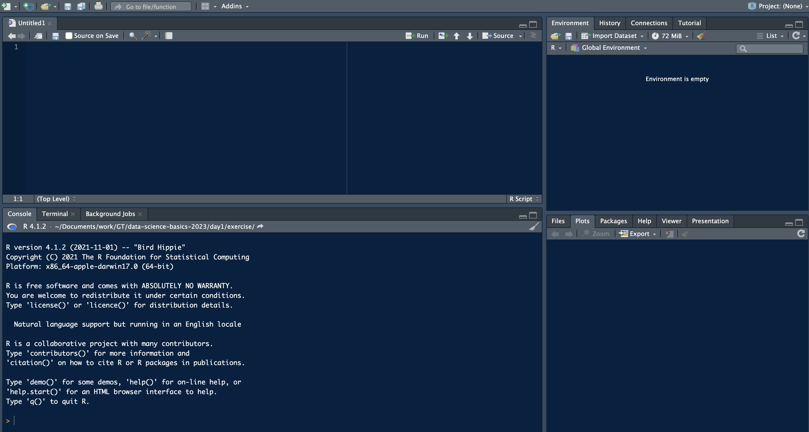
Loading data with RStudio
Import dataset button

Slide 25
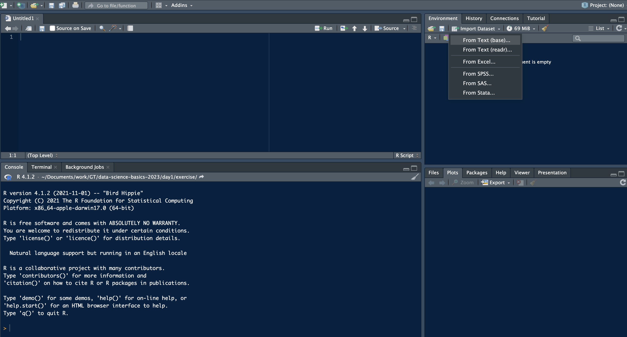
Loading data with RStudio
Several default options of data types, including Excel. Here, I’ll select the first option, using base R

Slide 26
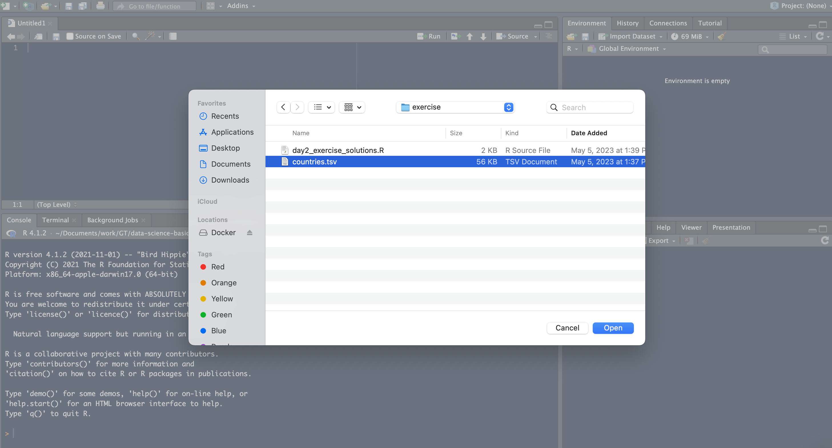
Loading data with RStudio
Select your data file, you might need to look around

Slide 27
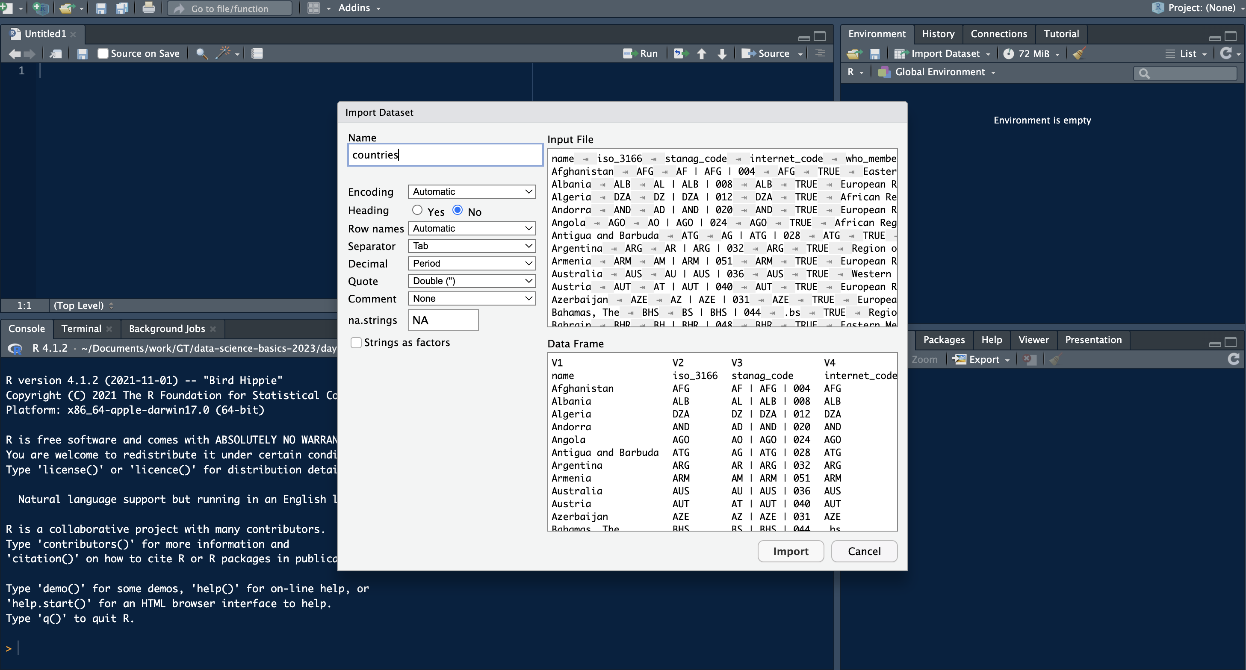
Loading data with RStudio
R will need some help, probably

Slide 28
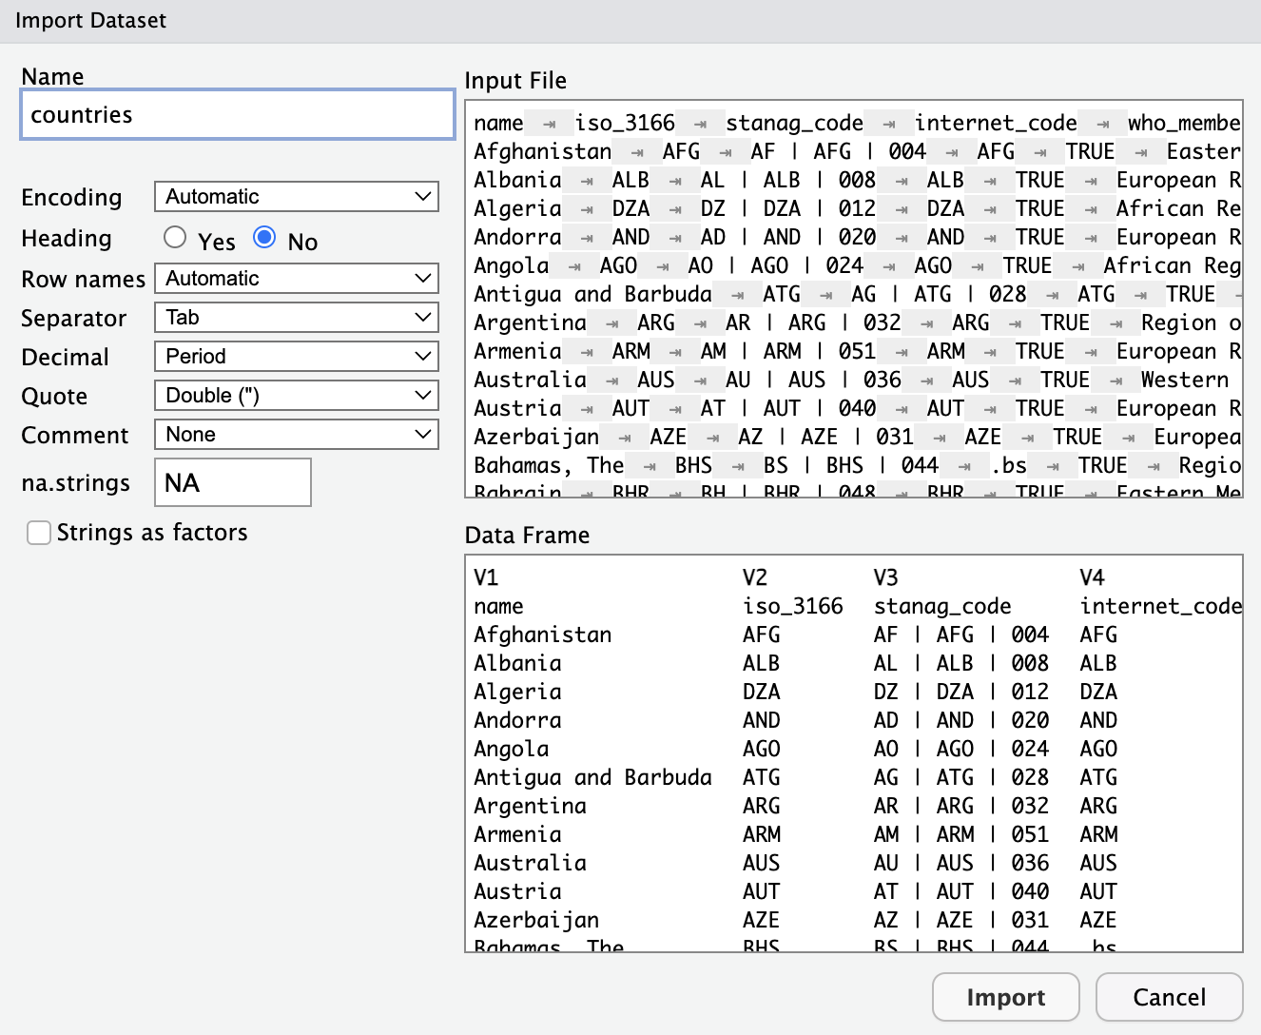
Loading data with RStudio
Here, I needed to tell R that this dataset does have a heading
R will need some help, probably

Slide 29
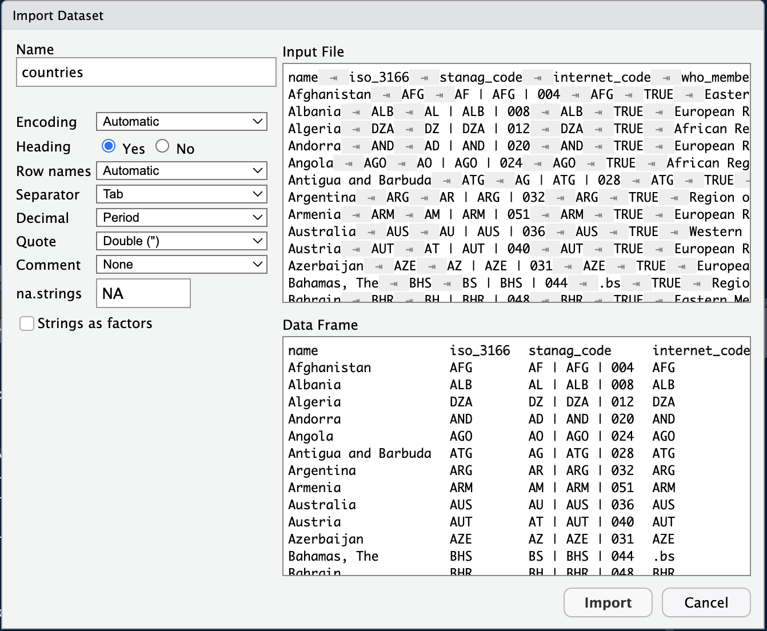
Loading data with RStudio
Fixed the heading!
R will need some help, probably
Click “Import”

Slide 30
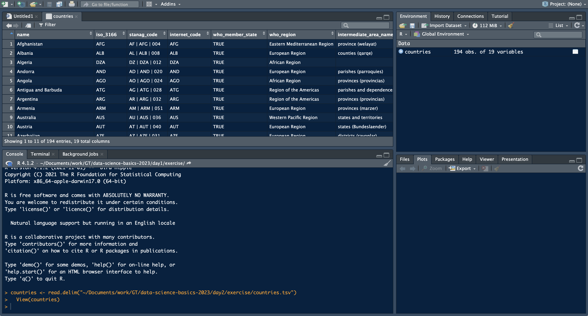
Loading data with RStudio
There are our data!

Slide 31
Loading data with RStudio
R Studio automatically write code for us, see read.delim() function

Slide 32
Loading data with RStudio
And the View() function told R to show us the data table above

Slide 33
Loading data with RStudio
countries dataset in our R environment

Slide 34
Workshop dataset
bit.ly/ghss-diplomacy-data-countries
countries dataset in our R environment

Slide 35
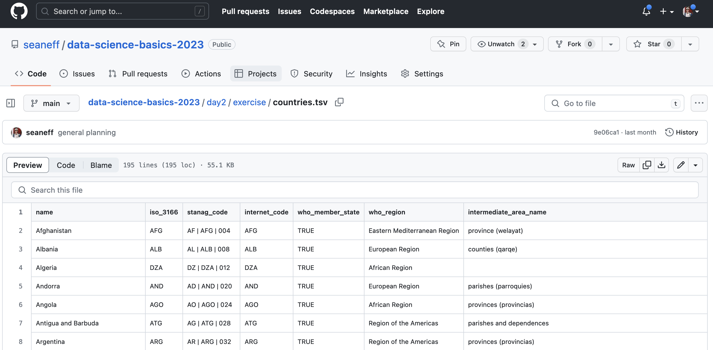
Workshop dataset
countries dataset in our R environment

Slide 36
Workshop dataset
countries dataset in our R environment

Slide 37
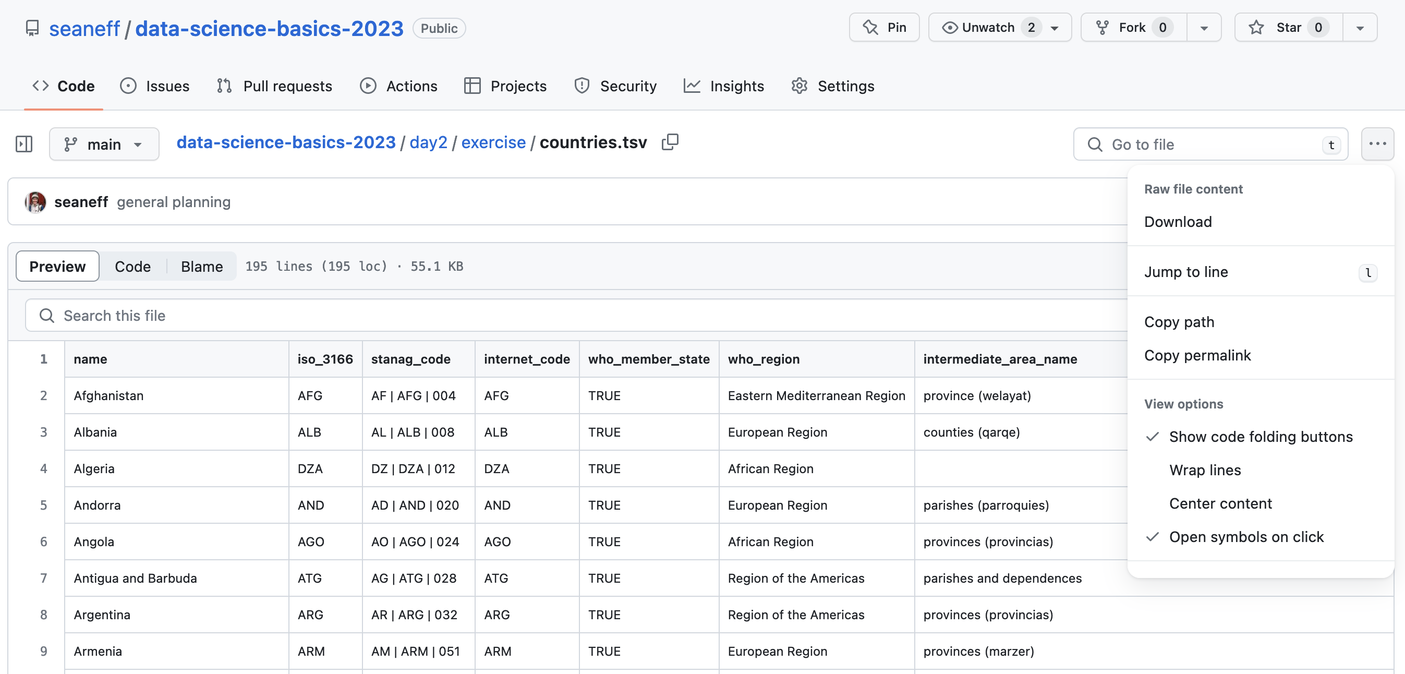
Workshop dataset
countries dataset in our R environment

Slide 38
Your turn
Go to bit.ly/ghss-diplomacy-data-countries
Download file “countries.tsv”
Save it somewhere on your computer
Read it into R
If you have issues, you can also try read.delim(" https://raw.githubusercontent.com/seaneff/data-science-basics-2023/main/day2/exercise/countries.tsv")
countries dataset in our R environment
Notes:
bit.ly/3qs51XU

Slide 39
Data structures in R

Slide 40
Data Structures in R
Yesterday we discussed vectors, today, we’re going to talk about other types of data structures in R. There are a few different types, but the ones we’ll talk about this week are:
vectors: group of data elements of a certain type (1D)
matrix: group of data elements of a certain type (2D)
data frame: group of data elements with different types

Slide 41
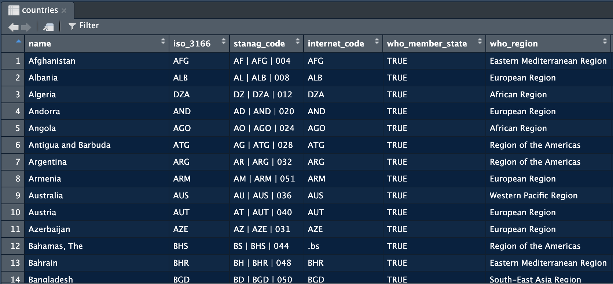
Vectors

Slide 42
Dataframe

Slide 43
Now you try!
Can you find a logical vector?
A string vector?
A numeric vector?

Slide 44
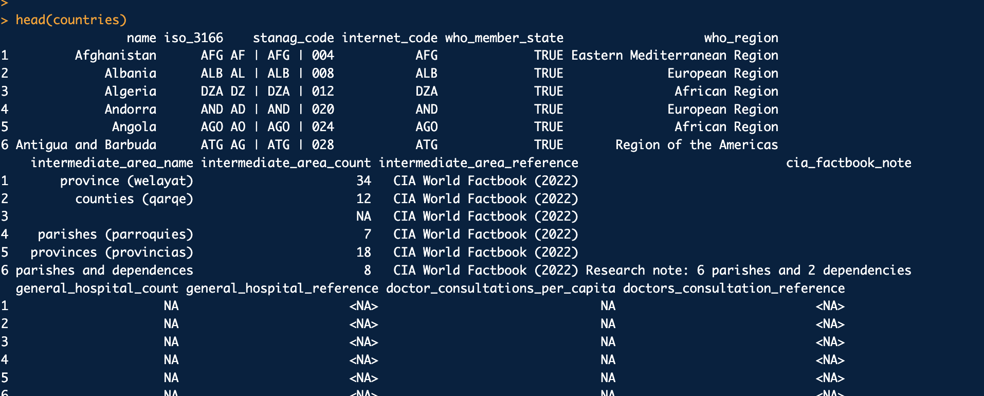
Exploring your dataset
head() function

Slide 45
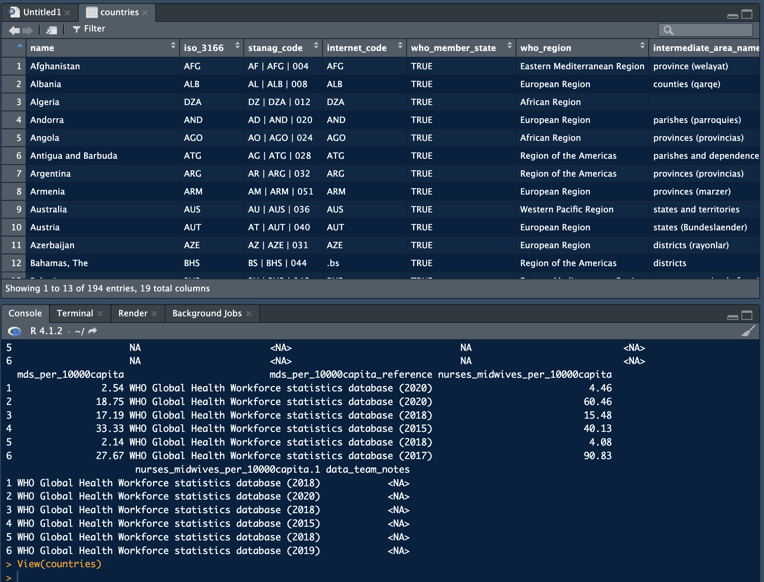
Exploring your dataset
View() function

Slide 46
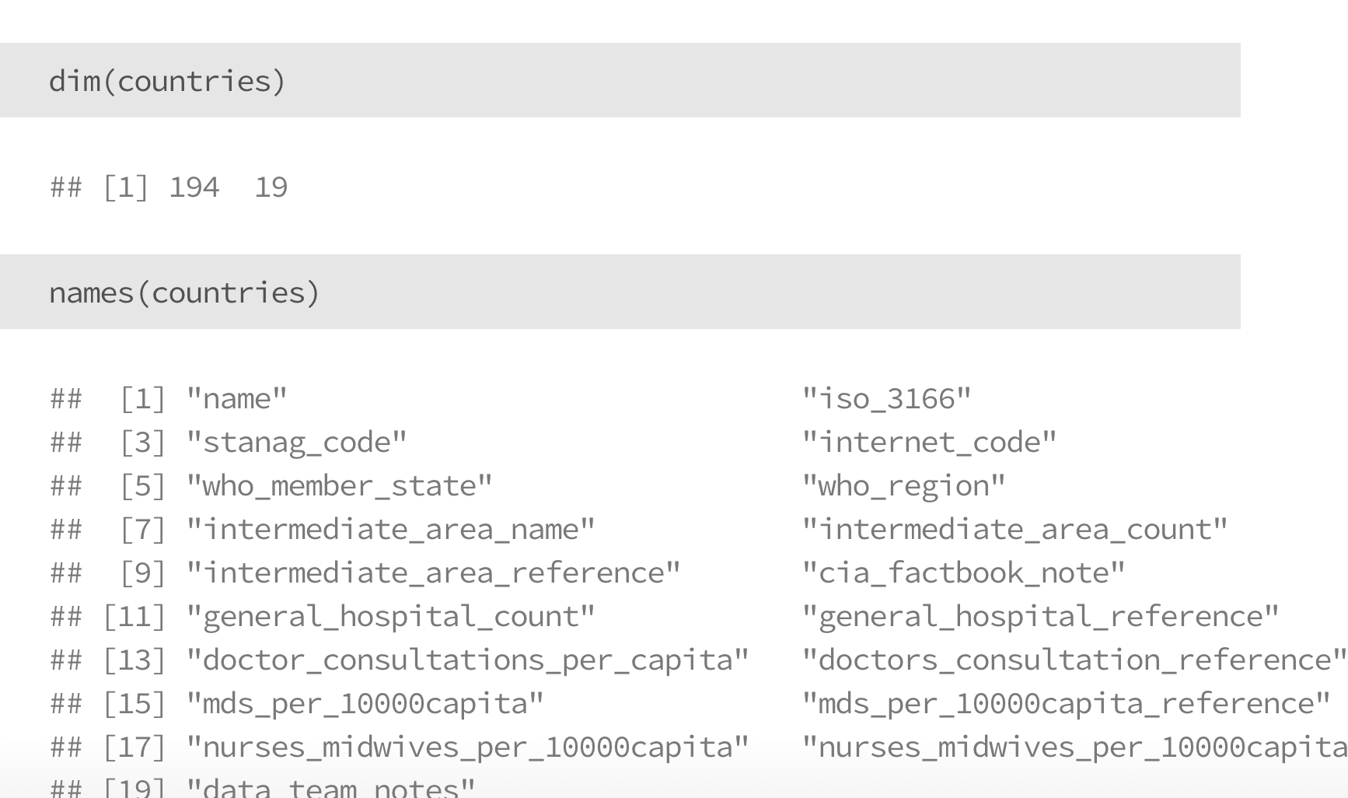
Exploring your dataset

Slide 47
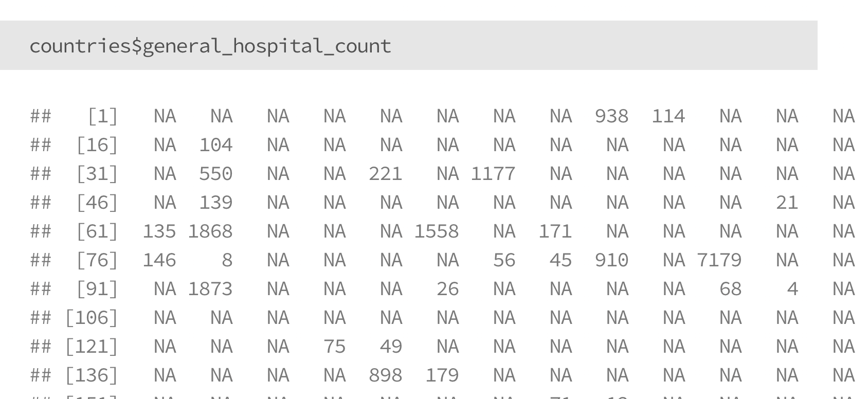
Accessing subsets of data
Using $ to call vectors

Slide 48
Now you try!
Take five minutes to explore this dataset
How many rows are there?
How many columns are there?
Can you use “$” to select a vector?

Slide 49
Data cleaning basics

Slide 50
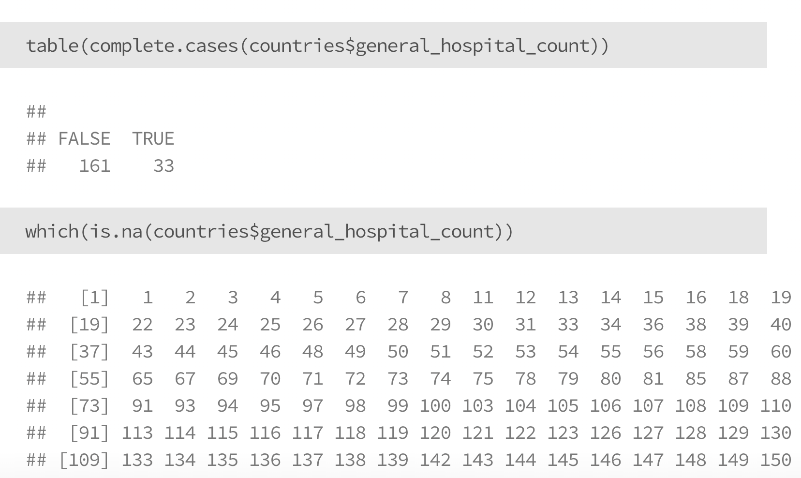
Check for missing values

Slide 51
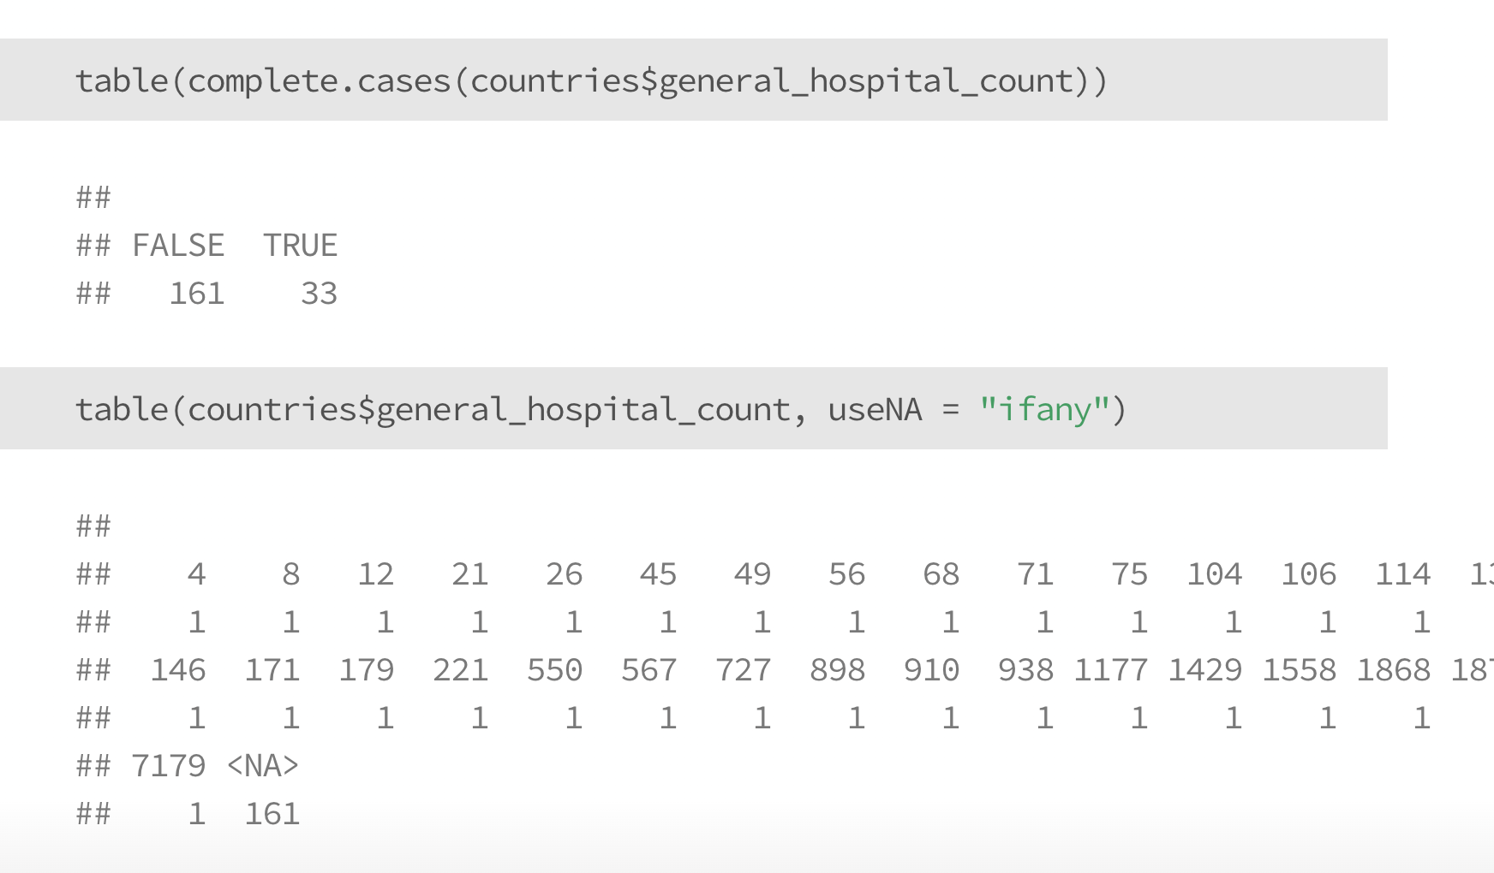
Check for missing values

Slide 52
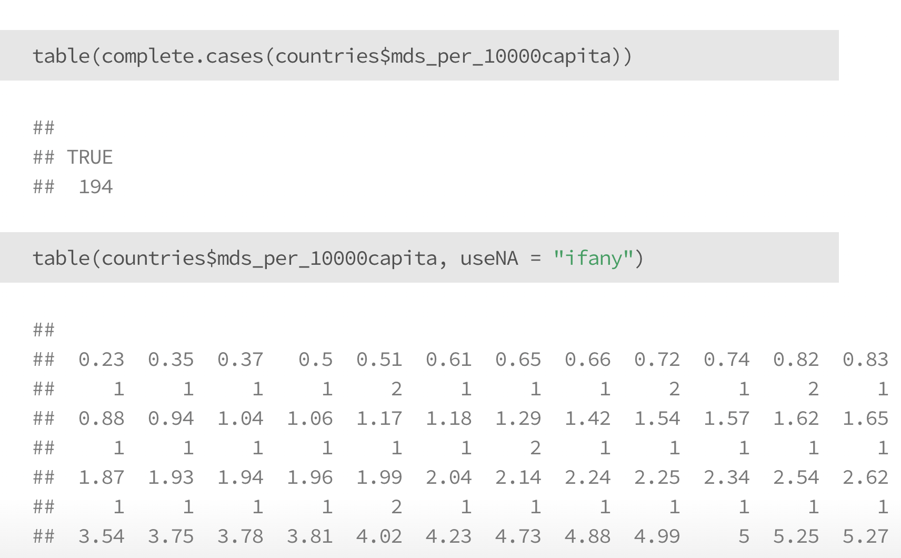
Check for missing values

Slide 53
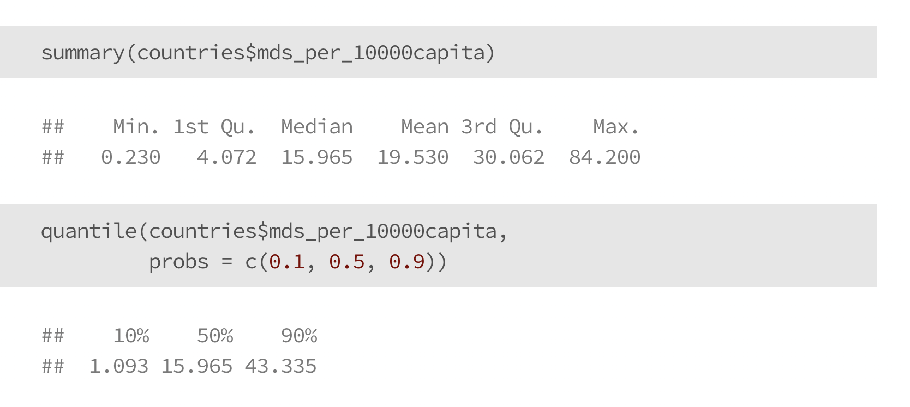
Ask questions about your data

Slide 54
Documenting your data, code, and results

Slide 55
Documentation
Throughout your analysis, documentation might be the single most important, and also the single most under-appreciated step of the process.
Documentation is helpful for :
current you: writing out simple, clear, documentation helps you think clearly
future you: you’ll inevitably forget why you did certain things, even if you can see your old code
others: hopefully other people will also use your work, and they need to know about it

Slide 56
Documentation
Different materials, and different types of analysis benefit from different types of documentation.
Datasets: Data dictionaries, rules to generate datasets
Code: Comments in code, README files
Analysis/Results: Methods documentation, in a word document, a google document, or in github

Slide 57
Documenting datasets
Data dictionaries
The most common way to document a dataset is a data dictionary. At a minimum, data dictionaries:
Define the columns (“fields”) of a dataset
Specify what a row corresponds to (e.g., one country)
Give context about what the data are, including where they come from and how often they are updated

Slide 58
Documenting datasets
Data dictionaries
Data dictionaries come in lots of formats and flavors. Work with the type that makes the most sense for who you are trying to communicate with.
You can see in the course references/ folder for today a few different examples of data dictionaries, with URLs for future reference.

Slide 59
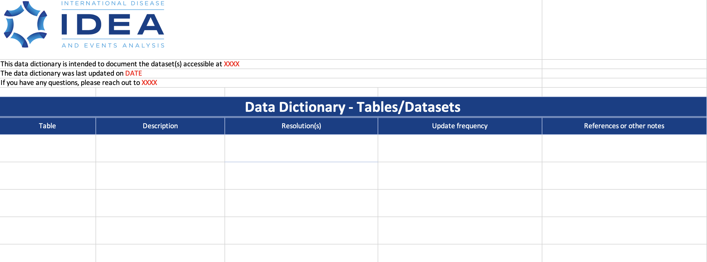
Documenting datasets
Data dictionaries

Slide 60
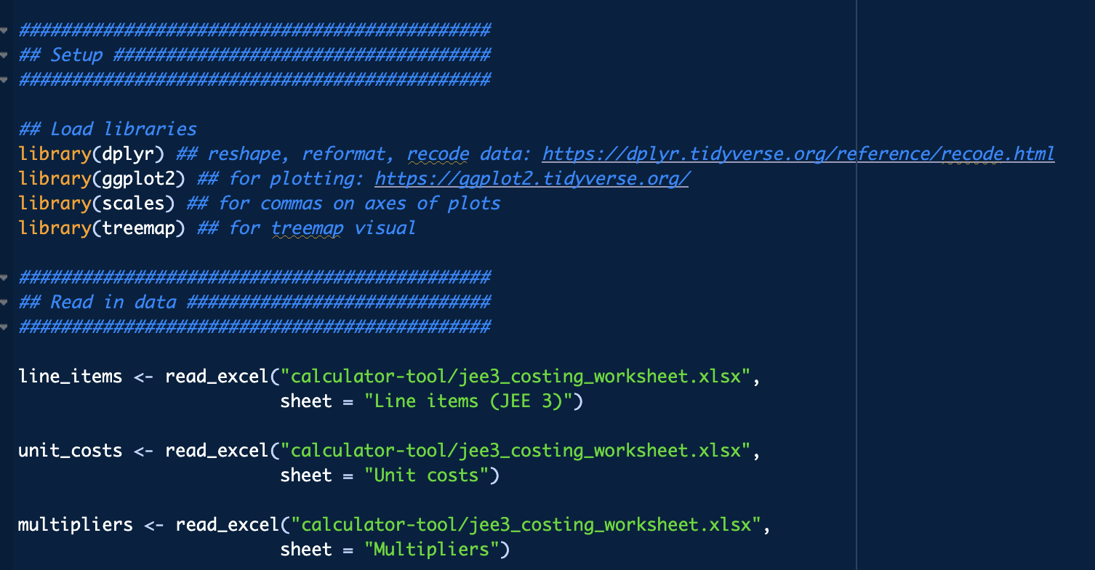
Documenting code
commenting your code
As you’re working through code, leave comments to define sections, or to explain what you’re doing.
# means a line of R is a comment

Slide 61
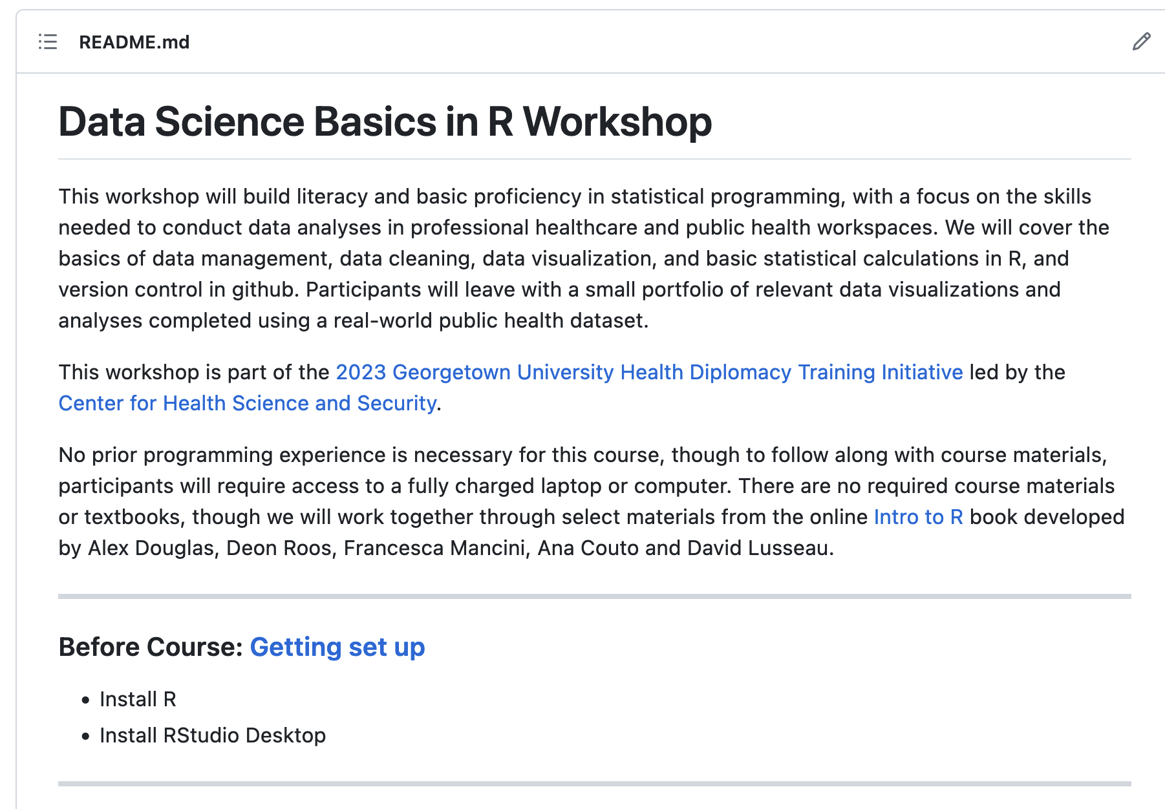
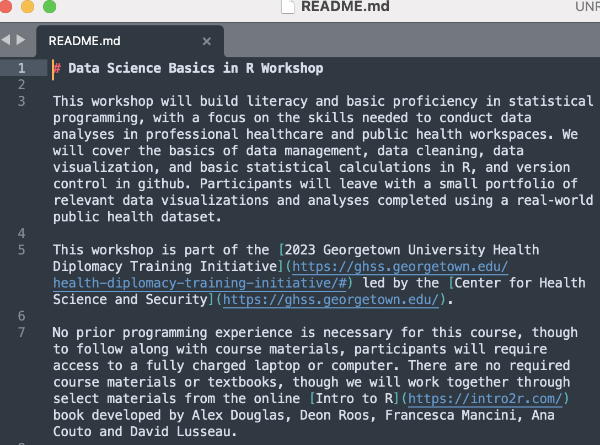
Documenting code
README files
README files summarize the contents of a specific folder
Common in github, rendered using Markdown

Slide 62
Reproducible results
We won’t cover it in detail in this workshop, but R is a great way to ensure that your code, and your results, are well documented and reproducible
Use a single version of a clean dataset
Document and version your data cleaning decisions
Store your code, results, & documentation in one spot

Slide 63
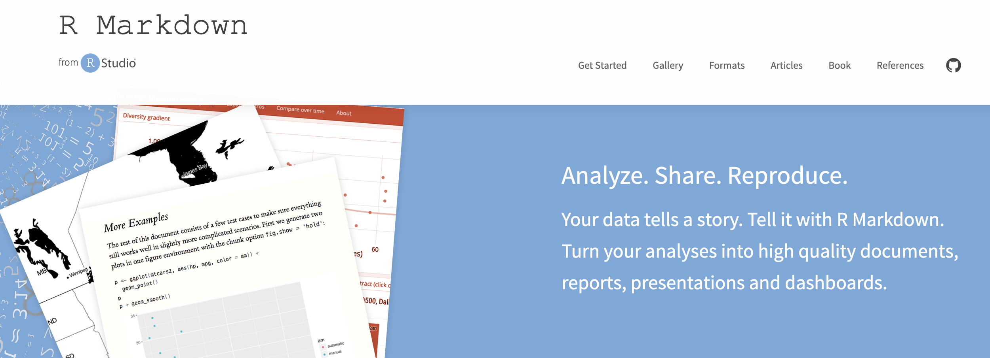
Reproducible results
R Markdown

Slide 64
Thank you!
See you tomorrow.
Please come with a fully charged laptop.
Lecture and course material adapted from Intro to R materials created by Alex Douglas, available online here, with corresponding free online textbook.

